Slide 1

OB/GYN Workforce vs Infant Mortality
Luke Ellison
Jeremy Stewart
Elyse Leuenberger

Slide 2

Why this story is worth telling
In addition to giving us key information about maternal and infant health, the infant mortality rate is an important marker of the overall health of a society.
Over 22,000 infants died in the United States in 2017.
Indiana has the 7th highest infant mortality rate in the US
OB/GYNs are among the surgeons with the lowest annual compensation.

Slide 3


Hypothesis
When comparing the number of active OB/GYN practitioners in each Indiana county to the infant mortality rate in those counties, we expect there to be a strong negative correlation between the two statistics.

Slide 4

Null Hypothesis
There is no correlation between the availability of OB/GYN practitioners and the infant mortality rate.

Slide 5

Summary Statistics
Mortality Rates
Mean: 4.46
Median: 3.0
Mode: 1.0
OB/GYN Workforce
Mean: 14.5
Median: 5.5
Mode: 1.0
County Populations
Mean: 71,142
Median: 33,978

Slide 6
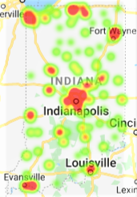



OB/GYN Presence

Slide 7
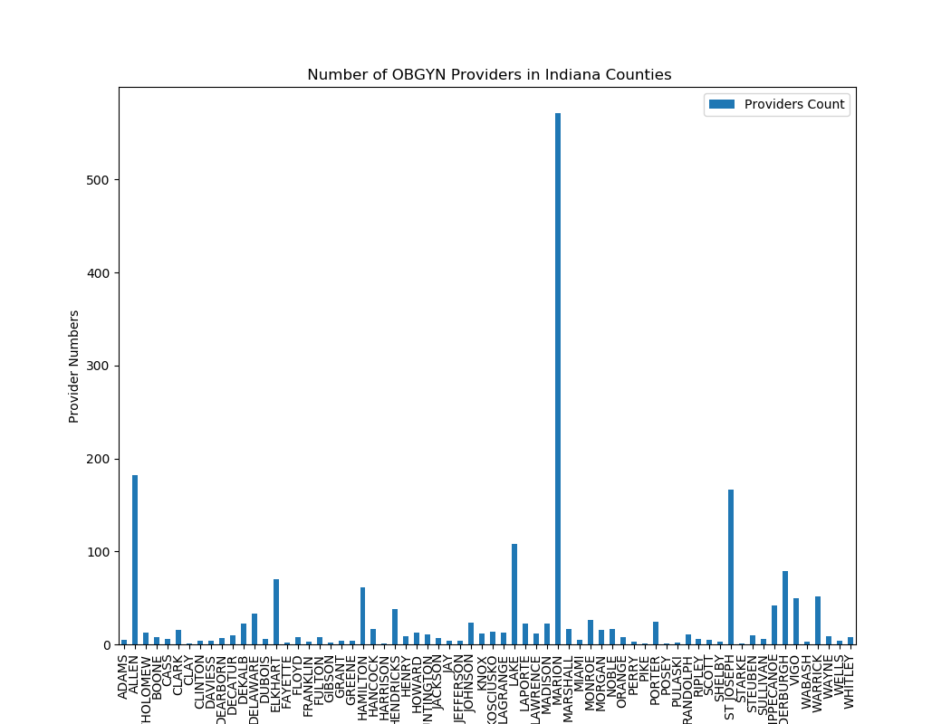
OB/GYN Presence

Slide 8
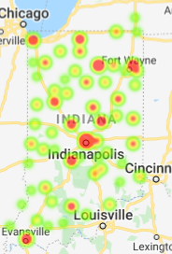
Total Deaths

Slide 9
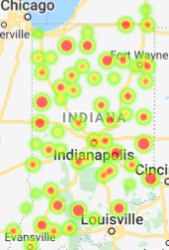
Mortality Rate (per 10,000 residents)

Slide 10
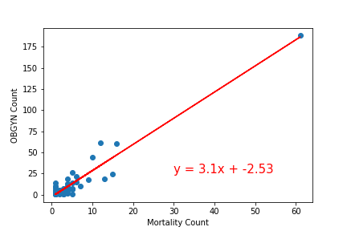
R Squared: 0.96
P Value: 1.05

Slide 11
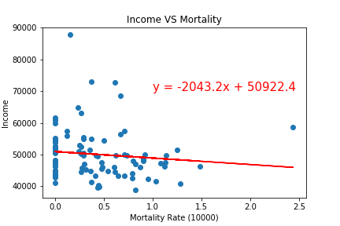
R Squared: -0.11
P Value: 0.29

Slide 12
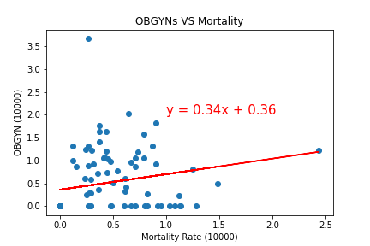
R Squared: 0.22
P Value: 0.03

Slide 13
Other things to consider:
The U.S. infant mortality rate over time
When are deaths occurring
Infant mortality rates by state
Infant mortality rates by race & ethnicity
How does the mortality rate compare amongst maternal ages
What are the most common causes
OB-GYN income comparisons

Slide 14
Sources
https://www.in.gov/indot/InGCS.htm
https://data.medicare.gov/Physician-Compare/Physician-Compare-National-Downloadable-File/mj5m-pzi6
https://www.census.gov/topics/population.html
https://hub.mph.in.gov/dataset/infant-mortality-by-county-year-and-underlying-cause-of-death
https://hub.mph.in.gov/dataset/count-of-ob-gyn-providers-by-county
http://data.indy.gov/
https://www.cdc.gov/reproductivehealth/maternalinfanthealth/infantmortality.htm

Slide 15

Thank you

